Slide 1
Nugget
Notes:
Title slide
Introduction of team members
Description of the application including its novelty
Targeted users (who would use your application)
Highlight of specific aspects of your application that your team finds most interesting (e.g., UI, back-end algorithms)
A list of what your team found easy and what your team found hard
Future work - what would you do if you continued to work on this application

Slide 2
Team Members
Arwa Farrag-
Scott McCullough-
Pinak Kapoor-
Malachai Purgahn-
Emily Goroza-
Sangmin Yun-

Slide 3
Our Application
Nugget is a virtual pet website in which individual users can login, create and customize their own pet, and interact with others. Users of Nugget have the ability to create their own ‘Nugget’ and customize them to their hearts content. They can access the Shop and purchase items to customize their Nugget, interact with other users through the Chat feature, and battle against their other nugget friends to impact their mental and physical statistics as well as their coin collection.

Slide 4
Targeted Users
This application is targeted towards everyone, as we feel that our creation is a wonderful way to destress from the hardships of daily life.
Anyone capable of using a computer and clicking around will find Nuggets easy to use.

Slide 5
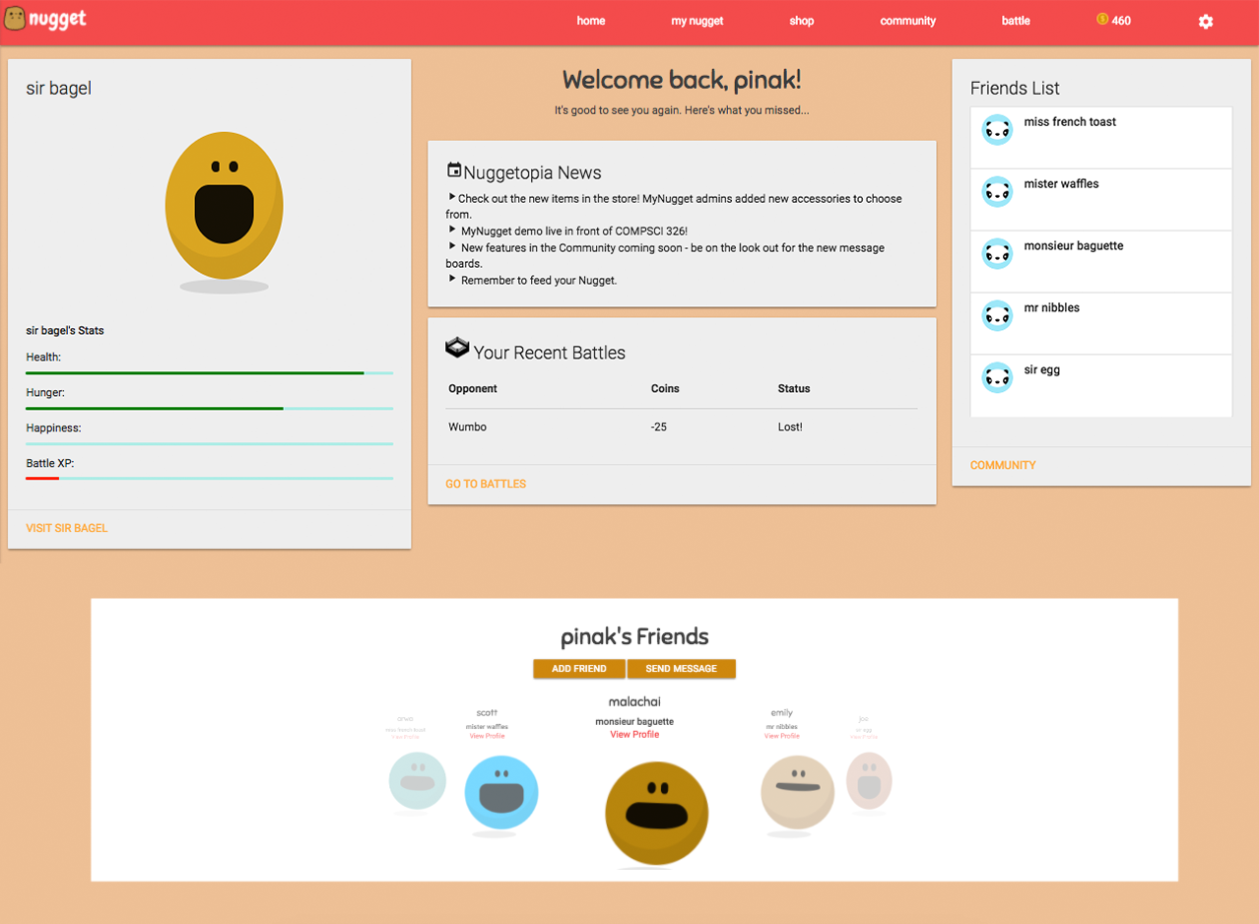
Highlights
Carousels Displaying Friends list
Displaying stats
Recent battles
Basically everything
Minimalistic UI
Captivating color scheme

Slide 6
Easy and Challenging
A few of our team members had previous experience with the CSS framework Materialize and were able to do a majority of the web pages back-end HTML very quickly. We found that implementing the rest of the CSS was very easy as well and helped make our website stand out from the rest.
We, as a group had many stutters when working with models and how they interacted each other. The issues we primarily had were having too many forms on one page and multiple models change when a form was edited.

Slide 7
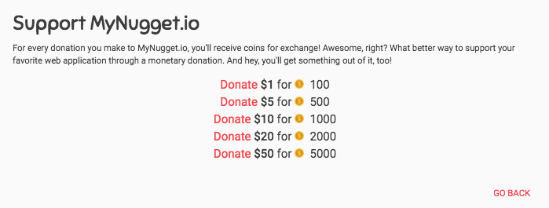
Future Work
Lastly, for future work on our application, we would like to implement the change email and change password functions with email authentication for our users. We would also like to update our shop page with more diverse items, possibly implement a live chat, a training battle option for users with no friends so they can fight AI creatures, and incorporate a microtransactions page that will allow users to buy in game coins through paypal.

